Slide 1




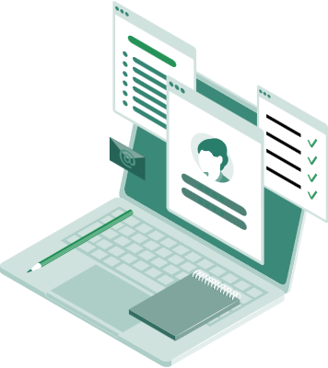

Learning and document reading solution
DolphinGroup
Pitch Deck 1.0
Knowledge at fingertips
dolphin.team111@gmail.com

Slide 2
Agenda
Meet the team
Our “startup”
Problems
Proposed solution
Team member
Spirit, culture
Overview info
Vision & Mision
Current context &
difficulties
What are we going to do?

Slide 3



Our team
Dang Loc CEO - Project Manager
Phuoc Tung CTO
Quoc Tuan Developer
- Leadership & technical skill
- Planning, coordinate
- Communicate between tech and non-tech
- Strong IT background
- Full-stack developer
- Responsible for leading & building final product
- Full-stack developer
- Expertise in business logic/rules
- Wide knowledge of tech-stack

Slide 4



Our team
Vi Khang Developer
Thu Huong Marketing executor, Business planner
Vi Triet Product Designer
- Execellent techinical skill
- Experiences from international competition
- Major in SE/AI/DS
- Conduct market research
- Planning for business and marketing
- Financial management
- Responsible for all kind of visual of the project
- Work relate to UI/UX

Slide 5
Team’s spirit & culture
Innovate
Enjoy
Compact
ICARE
Reliable
Active
Notes:
Simples is best, less is more

Slide 6
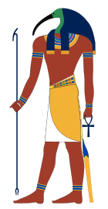

Introduce our startup
Brand
DolphinGroup
Product
Tagline
Knowledge at fingertips
Keyword (criteria)
Lean, Rapid, Personalized, Convenient
God of the knowledge, wisdom, writing, science in ancient Egyptian mythology
Strategy
Customer-centric
Tetu is a comprehensive learning tool that caters to individuals of all ages and backgrounds. With its innovative technology and engaging content, Tetu aims to transform the learning experience for its users.
Notes:
Talk about productivity
An open book is a timeless symbol of learning and knowledge, representing the idea that knowledge is always available and ready to be explored.

Slide 7

Vision & Mission
Our Vision
To empower the "rapid and lean" concept, positively impact people's behavior and study habits, and become top providers of effective working and learning digital solutions.
Our Mission
To provide a comprehensive and user-friendly learning platform, Tetu, that incorporates innovative technology, interactive features, and engaging content to enhance the learning experience and foster continuous development.

Slide 8
Problems
“
Many documents are in the form of digital asset
Read lots of separate resources to get deeper understanding or find ideas
Diffuse ways of learning language through articles/news
Demand to take note and easily review
”
Inefficient note-taking and organization
Read file in one app and take note in another app, notes are stored distributedly
Lack of a personalized learning experience
Resources is unsynchronous make learning process cannot meet user needs
Time-consuming and boring learning process
Spend lots of time to figure out how to manage learning material
Inability to track progress and measure results
Traditional way of lesson reviewing make it hard to evaluate learning journey

Slide 9

Solutions
Build a cross-platform app that is able to:
Read a document file format like PDF/HTML/markdown/epub
Directly take note in app with powerful text editor
Organize note in a structured and synchronous manner
Intergrate with other resource management tool like Notion
Quickly learn a word/collocation/idiom in the passages
Put notes/words in a dictionary/notebook/card for further revision
Target audience
Satisfy the criteria
High school/university student
Office worker
Learner
Age: Gen X – Gen Y
Convenient
Personalized
Rapid
Lean
Notes:
Củng cố, hỗ trợ, hướng đến

Slide 10
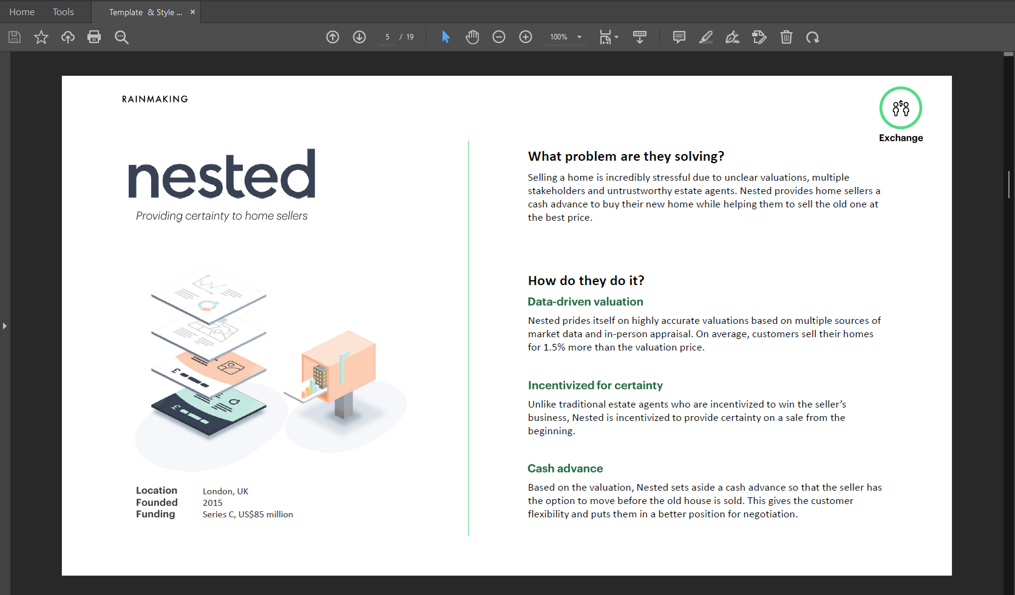
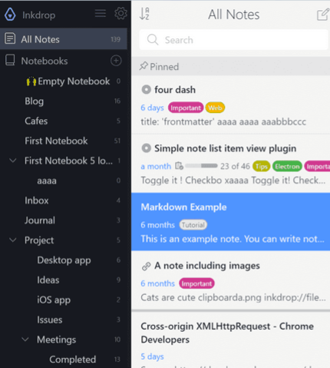
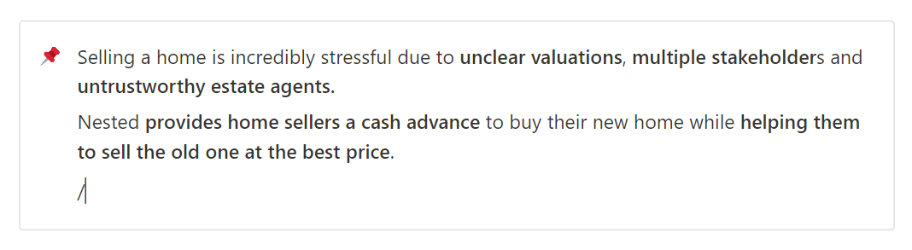
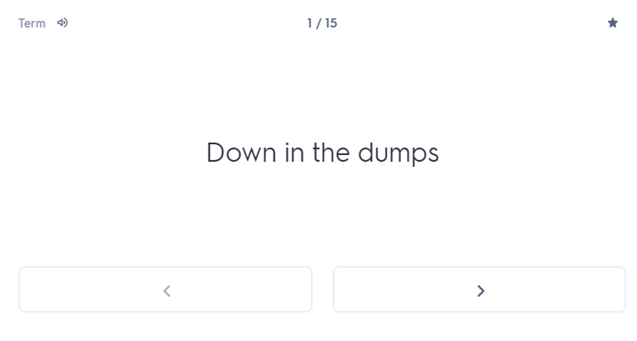
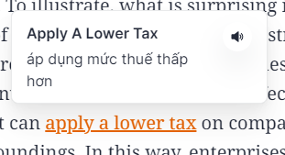
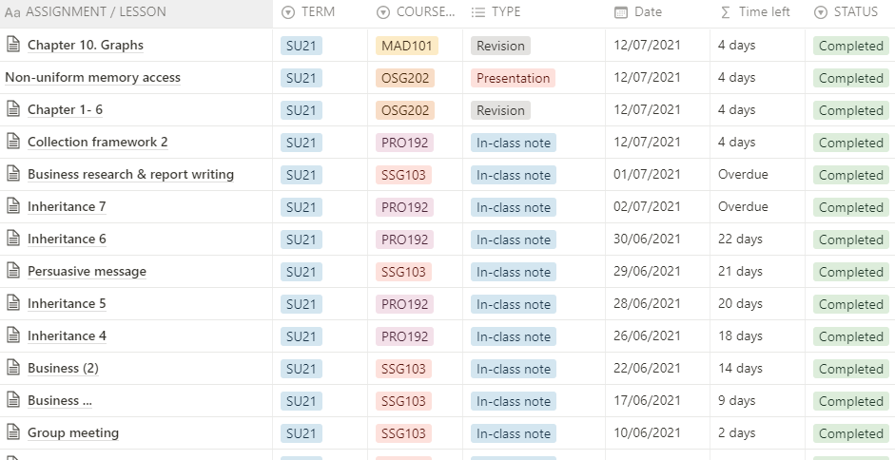
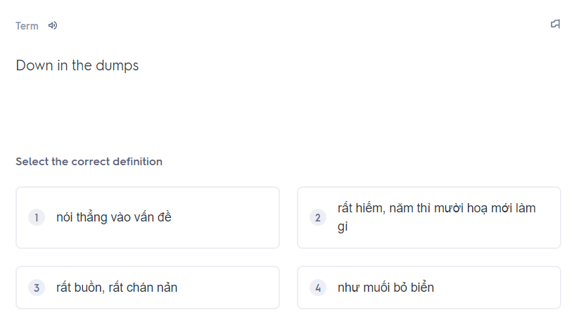
Moodboard
1. Read document files
2. Take note in app
3. Organize user’s notes
6. Store vocabs and revision
5. Learn a vocab
4. Intergrate with other tools

Slide 11

Executive summary
Problem
Read lots of separate resources
Inefficient note-taking and resources organization
Lack of personalization
Difficulties when reviewing those notes
Target audience
High school/university student
Office worker
Learner
Age: Gen X – Gen Y
Hobbies: learning, reading, researching
Solution
A hybrid-app can:
+ Read document file and take note in app
+ Organize notes in a structured and coherent manner
+ Create personal notebook to review, track progress and measure results
USP
Built-in note taking and intelligent organizing system
Integration with other tool
Less time-consuming for management
Goal
Positively impact people's behavior and study habits
Improve individual’s productivity, make learning effortless
Become top effective working and learning solution-providers

Slide 12


THANK YOU!
If you have any questions?
Don’t hesitate to ask us
or contact us
dolphin.team111@gmail.com
DolphinGroup

